Slide 1
Frito Lay Employee Attrition Exploratory Data Analysis
Zainab Anwar
October 31, 2024
Notes:
Today we will be conducting an Exploratory Data Analysis over Employee Attrition for Frito Lay, so let's get started

Slide 2
General Information
Who We Are: DDSAnalytics
Our Client: FritoLay
Our EDA topic: Factors leading to company attrition
Notes:
We are DDSAnalytics, and we specialize in talent management solutions for Fortune 100 companies
We are conducting this EDA for our client, Frito Lay, on the account of identifying factors contributing to employee attrition
The reason it is important to conduct this EDA is because high attrition rates can increase costs for the company. There are many competitors in the industry and in order to stay ahead of the game, our client (Frito Lay) would need to manage their employee turnover rates.

Slide 3
Overview
Establish possible factors leading to employee attrition
Explore trends in the data
Predict causes leading to employee attrition using Naïve Bayes model
Notes:
Today, we will be going over the top factors that contribute to employee attrition.
Then, we will look at some common trends between the data
Finally, we will predict employee attrition by implementing the Naïve Bayes model

Slide 4
Question of Interest
What are the top three factors that contribute to employee attrition?
Possible factors leading to attrition:
Job Satisfaction
Work Life Balance
Hourly Rates
Notes:
Today we will be answering the question: ___
We need to identify these factors, so that we can hopefully try to reduce the likelihood of employees leaving the company.
We will be exploring the following aspects that might lead to employee attrition
First, we will look into the following factors that could possibly lead to attrition based on intuition
Job Satisfaction
- b/c Employees with lower job satisfaction are more likely to leave.
Work Life Balance
- Where poor work-life balance could lead to higher attrition.
Hourly Rates
- b/c lower-paid employees might be more prone to leaving

Slide 5
Looking at the Data
Dataset: 'CaseStudy1-data.csv’
The dataset consists of 870 observations and 36 features
Interesting Data:
The 'EmployeeCount' column consists of only '1’s
The 'PerformanceRating' column consists of only '3's and '4’s
No missing values
Notes:
The dataset being used is from the 'CaseStudy1-data.csv' file
The dataset consists of 870 observations (in this case employees) and 36 features
Glancing over the dataset, we saw some interesting variables.
For example, EmployeeCount
The 'PerformanceRating' column consists of only '3's and '4's which is a bit unusual, since there usually should be some lower ratings in a dataset of this size, so this might be showing some bias
Also, surprisingly, there were no missing values, which was a positive

Slide 6
Intuitive Aspects
Notes:
These aspects are the ones that just come to mind when thought about intuitively

Slide 7
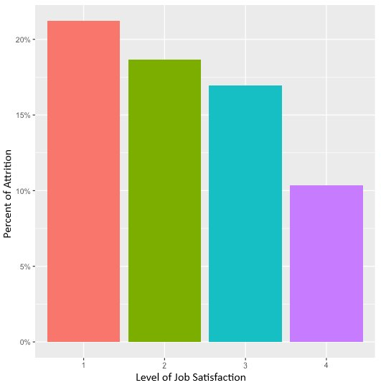
Aspect #1
Percentage of Attrition based on Level of Job Satisfaction
21.5%
18.5%
17%
Percentage of Attrition based on Level of Job Satisfaction
10.5%
Notes:
So the first aspect we will be looking at is the Percentage of Attrition based on the Level of Job Satisfaction.
(click) We can see that there are 4 levels of job satisfaction where 1 is the least satisfied, and 4 is the most satisfied. Around 22% of people claimed that they were not satisfied with their jobs. And just a little above 10% of people claimed that they were satisfied with their job. So what this says is that there is a decrease in the percent of attrition as people are more satisfied with their jobs.

Slide 8
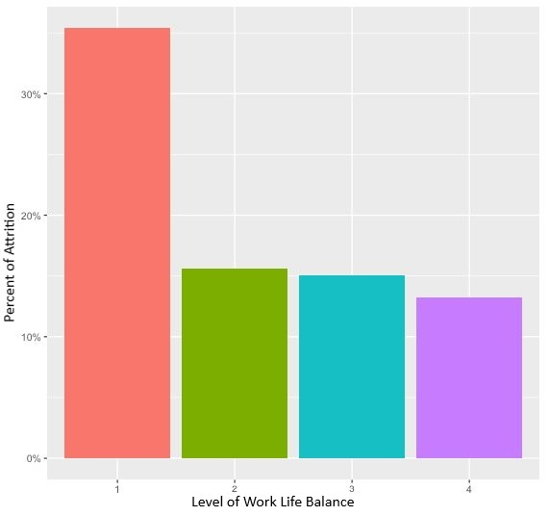
Aspect #2
Percentage of Attrition based on Level of Work Life Balance
36%
Percentage of Attrition based on Level of Work Life Balance
15.5%
15%
13%
Notes:
Next we will explore why people may be dissatisfied with their jobs,
so the next aspect we will be looking at is the Percentage of Attrition based on the Level of Work Life Balance
(click) Here we have a graph that compares the WorkLifeBalance to the Percentage of Attrition. The WorkLifeBalance variable is also based on a scale of 1-4, 1 being not enough worklifebalance, and 4 being excellent worklifebalance. We can see that around 36% of people are leaving the company and claiming that there is no worklifebalance. While the people who rated worklifebalance being a 2 or 3 have around the same percentage of attrition, which is around 15%-16%. And the people who claim to have excellent worklifebalance have an attrition rate of around 13%.
So there is a smaller attrition rate as people have a better work life balance.

Slide 9
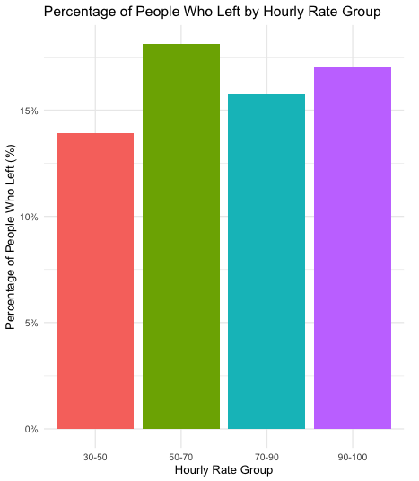
Aspect #3
18%
17%
16%
14%
Percentage of Attrition based on Hourly Rates
Percent of Attrition
Notes:
Finally, the last aspect we will be looking at is the Percentage of Attrition based on the Hourly Rates of people working here.
(click) In this graph, the hourly rates have been sorted in groups, where the minimum value is $30 per hour and the max is $100 per hour. So, as shown in the graph, the group with the highest attrition rate is the group making 50-$70 an hour, while the group with the lowest attrition rate is the group making the lowest amount of money which is 30-$50 an hour.
My assumption was that the people making the lowest amount hourly would be the group that would have the highest percent of attrition, though by this evidence, it doesn’t seem like it, so we will need to further investigate this by possibly comparing the hourly rates by the Job Level, since employees in higher job levels are often paid more.
Compare Hourly Rate to Job Satisfaction
This could help you see if there’s a relationship between pay and satisfaction, and whether low-paid employees are still satisfied (less likely to leave).
Compare Hourly Rate to WorkLifeBalance
Lower-paid employees might also have a worse WorkLifeBalance, which could contribute to higher attrition.

Slide 10
Statistically Calculated Aspects
Notes:
These aspects were statiscally calculated by conducting a t-test with all the observations against attrition one by one. The following observations have been taken into account according to their low p-value compared to the rest of the observations

Slide 11
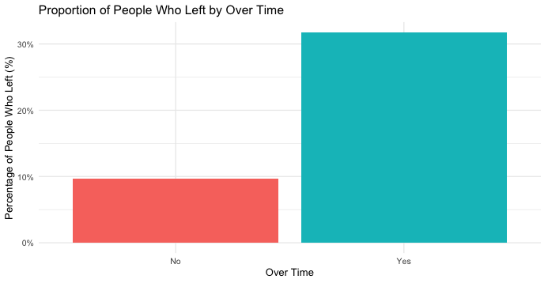
Aspect #4
Percentage of People Who Left by Over Time
32%
Percentage of People Who Left by Over Time
Percent of Attrition
10%

Slide 12
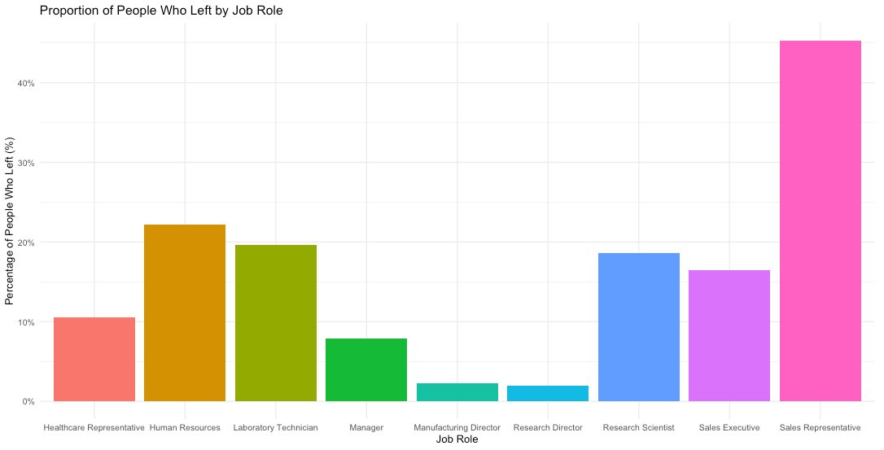
Aspect #5
Percentage of People Who Left by Job Role
45%
Percentage of People Who Left by Job Role
22%
Percent of Attrition
19%
18%
16%
11%
8%
2%
1.8%

Slide 13
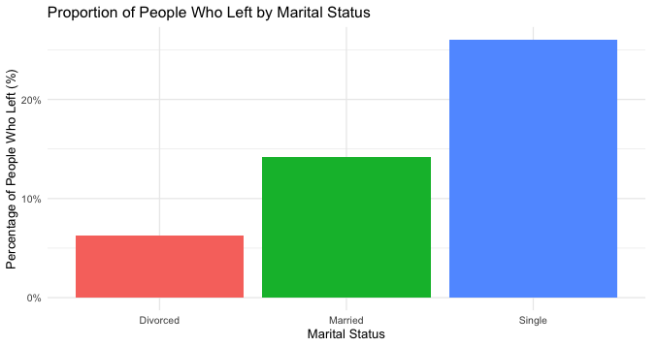
Aspect #6
Percentage of People Who Left by Marital Status
26%
Percentage of People Who Left by Marital Status
14%
Percent of Attrition
7%

Slide 14
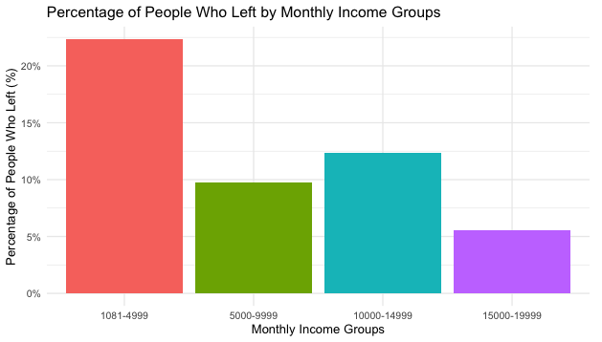
Aspect #7
22%
Percentage of People Who Left by Monthly Income Groups
12.5%
Percent of Attrition
9.5%
6%

Slide 15
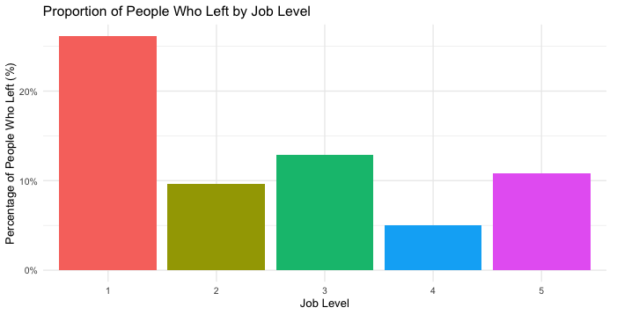
Aspect #8
Percentage of People Who Left by Job Level
26.5%
Percentage of People Who Left by Job Level
Percent of Attrition
13%
11%
9%
5%

Slide 16
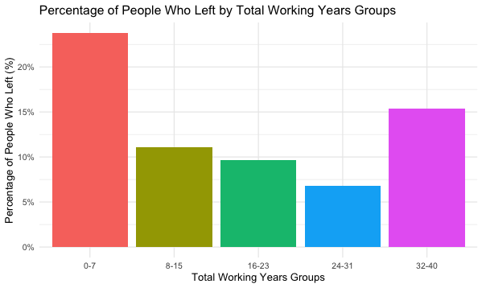
Aspect #9
23.5%
Percentage of People Who Left by Total Working Years Groups
15.5%
Percent of Attrition
11.5%
9%
7%

Slide 17
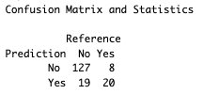

Naïve Bayes Model
Looking at the confusion matrix, we have:
127 True Negatives
19 False Positive
8 False Negatives
20 True Positives
Notes:
“
Accuracy (84.48%): Overall we had an 84.48% accuracy on whether employee would stay or leave.
Sensitivity (true positive):
86.99%, Correctly identified those who actually left the company (20 (true positive) vs 8 (false negative)),
Specificity:
71.43%, Incorrectly predicted employees would leave than when they actually stayed (127 (true negative) vs 19 (false positive))
F1:
90.39% Good balance between precision and recall, suggesting it performed well in identifying, yes employees attritted, without too many false positives/negatives
”

Slide 18
Conclusion
Top 3 Factors that Contribute to Employee Attrition:
Job Satisfaction
Work life balance
Monthly Income
Notes:
To conclude, the evidence from this Exploratory Data Analysis suggests that our client Frito Lay needs to try and increase their employees' job satisfaction, try to raise the work-life balance, and focus on adjusting monthly incomes in order for the attrition rates to decrease. So keeping the employees happy means keeping them within the company!

Slide 19
Questions?
For any questions, feel free to reach out!
Zainab Anwar
Email: zanwar3@smu.edu

